Slide 1
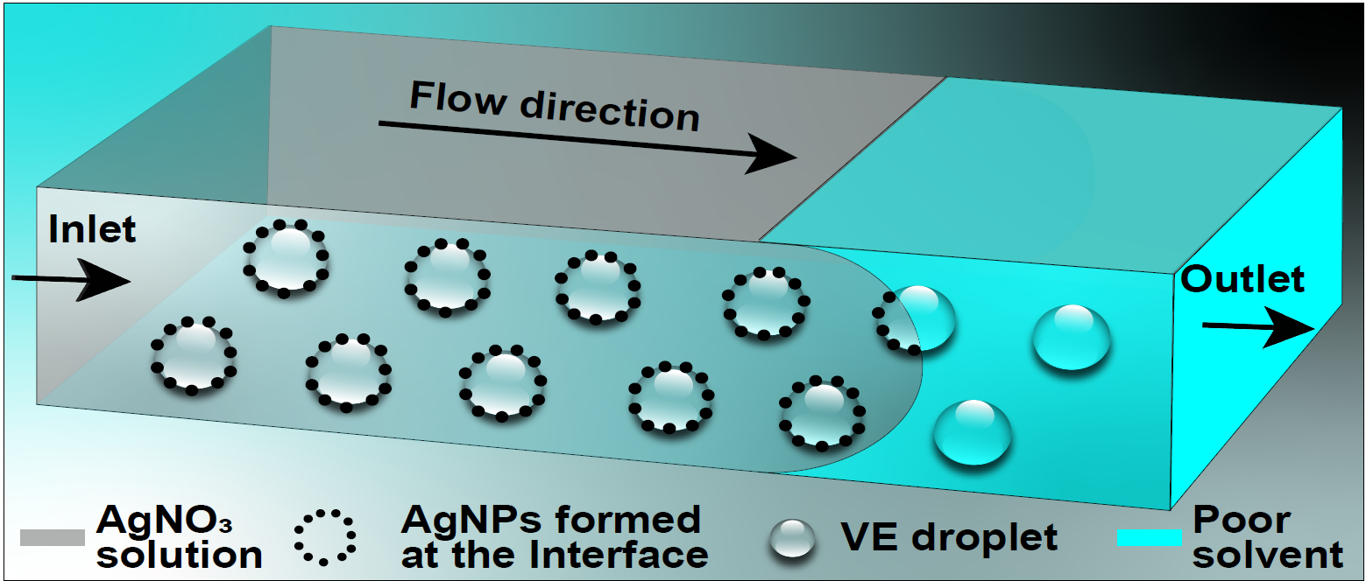

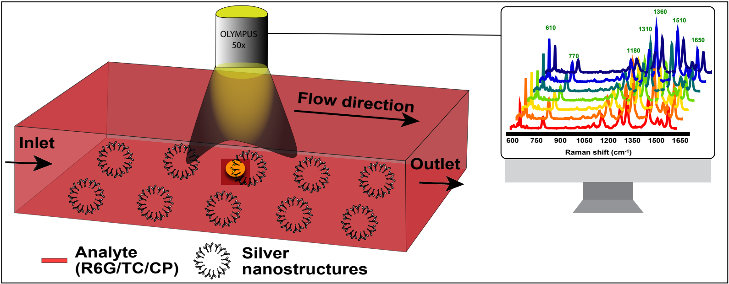
a)
b)
Ouzo
Colloidal
Solution
AgNP Solution
Analyte-AgNP Colloidal Droplet
Raman Spectra
Collection
Ethanol Evaporation and Octanol Drop Nucleation
Octanol Coalescence and Growth
Aggregate with Analyte

